Slide 1
Portville ny community forum
A discussion on our strengths, weaknesses, opportunities, and threats…and how to plan a sustainable, successful future.

Slide 2
Successful small communities…..
Have a vision for the future
Inventory their assets (recreational, natural, educational, architectural)
Build plans around existing assets
Use incentives and education, not just regulation and enforcement
Pick and choose among development projects (community identity > corporate design)
Pay attention to PLACE: People choose location/lifestyle ahead of employment
Have strong leaders and committed citizens

Slide 3
Successful small towns know….
Quality of life is a competitive advantage.
In-migration is key to growth and sustainability: new residents, new workers, new tourists, new visitors

Slide 4
Do you have a mission? A VISION?
A Mission Statement concisely describes: Who you are, what you do, who you serve, why you exist?
A Vision Statement concisely describes: What you aspire to be, a “stretch” from current reality, an ideal.

Slide 5
Your Strategic Plan
Strategic Planning is a process that explores options and makes decisions about an organization’s future, and implements actions that guide the organization toward its vision while honoring and retaining its mission.
A Strategic Plan is contextual and integrated, with budgets, actions, assessments, etc.
A Strategic Plan is a fluid, living document…a tool to be used, not a “coffee table book.”
A Strategic Plan should be revisited, updated, and (possibly) amended periodically.

Slide 6
Why A Strategic Plan?
Build on assets and identify weaknesses
Anticipate problems/challenges
Explore new directions/partnerships
Share your vision with other stakeholders
In terms of Jim Collins and Good to Great, identify your “Hedgehog”

Slide 7
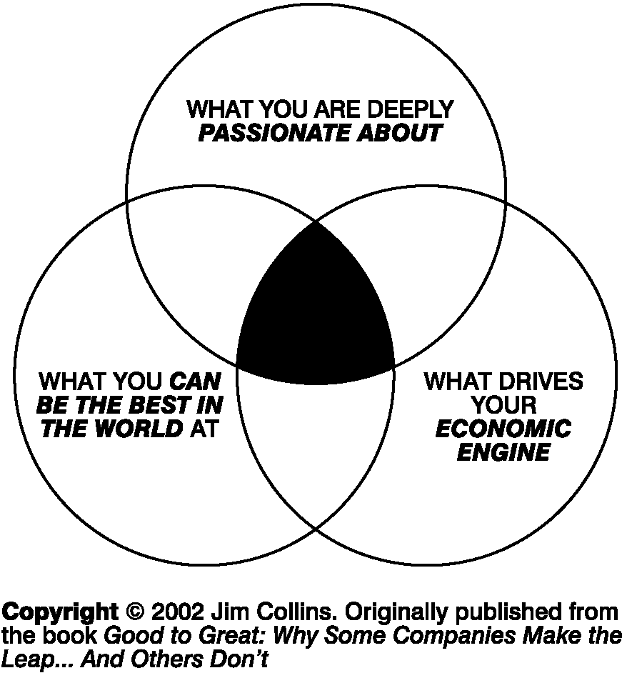
What is Your Hedgehog?

Slide 8
The Plan in Context
The Strategic Plan should be reviewed and updated regularly, and a critical tool in the budgeting and resource allocation process.
ASK: How does this allocation of time, money, or other resources move us toward our vision?
Incorporate the Plan into Budgeting, Resource Allocation, and Institutional Effectiveness…but ultimately ALL DECISION-MAKING.

Slide 9
What it’s Not
The Strategy Statements should be goals and not assumptions (e.g. having a balanced budget, taking good care of facilities, are probably more fitting as assumptions, not strategic goals.
Ways in which we do business are also typically not strategic goals, but they can be a part of a values statement – supplemental to the plan. (e.g. we treat staff/customers with respect; we value diversity)

Slide 10
The Elements of a Strategic Plan
VISION – What we aspire to be; a “stretch” goal and future position
MISSION – The reason why we exist, what we do, who we serve.
CORE VALUES: The way we do business, how we operate daily, our culture, what’s important to us. This includes assumptions or “givens,” so long as they don’t tie down your creativity.

Slide 11
Elements of a Plan, Cont’d
STRATEGIES – Broad goals that lead us to our Vision
OPERATIONAL PLAN – Actions, objectives, tactics that enable us to achieve strategies (SMART – Specific, Measurable, Achievable, Relevant/Realistic, Time-based)
KPI – Key Performance Indicators – measures of success and/or progress toward Strategic Goals

Slide 12
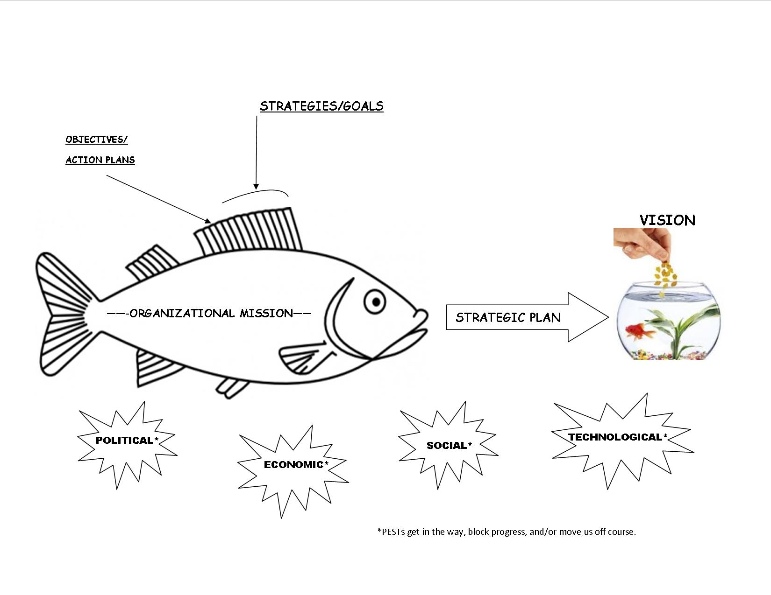
The Strategic Fish diagram

Slide 13
The Planning Funnel: Issues…strategies…objectives…actions
Environmental Scan – Internal, External
SWOT Analysis
Emerging Critical Issues
Priority Strategies
Annual Objectives
Operational Plans
Ongoing Assessment

Slide 14
Strategies
Given all of the above, what strategies will move us closer to our ideal vision for the future?
Are there any strategic changes we can make from our current course of business that will help move us in a more positive and successful direction?
What must be addressed in the new plan and rises to the top of the priority list?

Slide 15
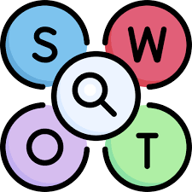
SWOT Analysis
Consider the INTERNAL Strengths and Weaknesses of your organization.
Consider the EXTERNAL Opportunities and Threats for your organization.
An analysis of these four “quadrants,” considered along with financial/feasibility factors will help identify emerging critical issues and priorities.

Slide 16
SWOT Analysis Internal External Build on Strengths Exploit opportunities Resolve Weaknesses Avoid Threats

Slide 17
Group discussion - SWOT
If you had the opportunity to put some or all of your retirement savings into “Portville Stock,” (which paid dividends based on community success), please list:
3 Main Reasons to Invest (Major Strengths/Opportunities)
3 Concerns that keep you from investing (Weaknesses/Threats)
One audacious, bold new initiative that could improve/grow the community and give you more confidence.

Slide 18
Emerging Critical Issues: of all the issues in the swot…
What MUST be addressed in the new plan?
What rises to the top of the priority list?
(time to connect the dots!)

Slide 19
STRATEGY STATEMENTS

Slide 20
Completing the Plan
Strategic Goal Statements should be reviewed at least annually and revised accordingly. (3-4 Statements)
Objective Statements should be created annually for each Strategic Goal (unless completed).
Action Plans will be developed for each objective (typically by staff or committees), with results reported periodically to the board.

Slide 21
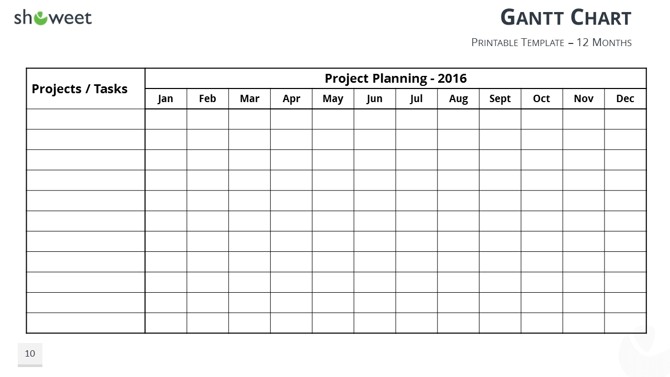

Slide 22
